Slide 1
Chapter 4
Requirements Evaluation
Source of PP slides :
- Lamsweerde, A. V. 2011. Requirements Engineering: From System goals to UML Models to Software Specification. 2nd ed.Wiley.
- Weigers, K. And Beatty, J. 2013. Software Requirements. 3rd edn. Microsoft Press.

Slide 2
Lesson Objectives
To understand the concept of Inconsistency Management
To explain the activities involved in Risk Analysis and Risk Management
Differentiate qualitative and qualitative risk assessment techniques
Evaluating alternative options for decision making
To understand what is Requirements Prioritization

Slide 3
Chap.1: RE products and processes
alternative options
Chap. 2 & 3:
Chap. 4:
Elicitation &
Analysis
techniques
Evaluation
techniques
consolidated
start
agreed
requirements
requirements
documented requirements

Slide 4
Introduction
Requirement evaluation - Negotiation-based decision making involved : (as introduced in Chapter 1 ...)
Identification & resolution of inconsistencies
Identification, assessment & resolution of system risks
Comparison of alternative options, selection of preferred ones
Requirements prioritization

Slide 5
Requirements evaluation: outline
Inconsistency management
Types of inconsistency
Handling inconsistencies
Managing conflicts: a systematic process
Risk analysis
Types of risk
Risk management
Risk documentation
DDP: quantitative risk management for RE
Evaluating alternative options for decision making
Requirements prioritization

Slide 6
Inconsistency management
Inconsistencies are highly frequent in RE
inter-viewpoints: each stakeholder has its own focus & concerns,
Eg: Sales department vs Inventory Department
intra-viewpoint: conflicting quality reqs,
Eg: Usability vs. Security, Performance vs. Safety etc
Inconsistencies must be detected and resolved ... WHY???
→ (anything may be developed from inconsistent specs)

Slide 7
Types of inconsistency in RE
Terminology clash: same concept named differently in different statements
e.g. “Participating” & “Attending” meeting
Designation clash: same name for different concepts in different statements
e.g. participant in a meeting - participating full meeting till ends
- participating partial meeting
Structure clash: same concept structured differently in different statements
e.g. “latest return date” - as time point i.e FRI, 5pm
- as time interval i.e. FRI

Slide 8
Types of inconsistency in RE (2)
Strong conflict: statements not satisfiable together
i.e. logically inconsistent: S, not S
e.g. “participant constraints may not be disclosed to anyone”
vs “the meeting initiator should know participant constraints”
Weak conflict (divergence): statements not satisfiable together under some boundary condition
i.e. strongly conflicting if B holds: potential conflict
MUCH more frequent in RE
e.g. (staff’s viewpoint)
“patrons shall return borrowed copies within X weeks”
vs. (patron’s viewpoint)
“patrons shall keep borrowed copies as long as needed”
B: “a patron needing a borrowed copy more than X weeks”

Slide 9
Handling inconsistencies
Handling clashes in terminology, designation, structure: through agreed glossary of terms
Weak, strong conflicts: more difficult, deeper causes...
Often rooted in underlying personal objectives of stakeholders => to be handled at root level and propagated to requirements level
Inherent to some non-functional concerns (performance vs. safety, confidentiality vs. awareness, ...) => exploration of preferred tradeoffs
Example: spiral, negotiation-based reconciliation of win conditions [Boehm et al, 1995]

Slide 10
Managing conflicts: a systematic process
Step 1 : Identifying Overlapping Statements
Overlap = reference to common terms or phenomena
precondition for conflicting statements
e.g. gathering meeting constraints, determining schedules

Slide 11
Managing conflicts: a systematic process
Step 2 : Detect Conflicts & Document Them
Conflict detection can be done by...
informally
using heuristics on conflicting req categories
“Check information req & confidentiality req on related objects”
“Check reqs on decreasing & increasing related quantities”
using conflict patterns
formally

Slide 12
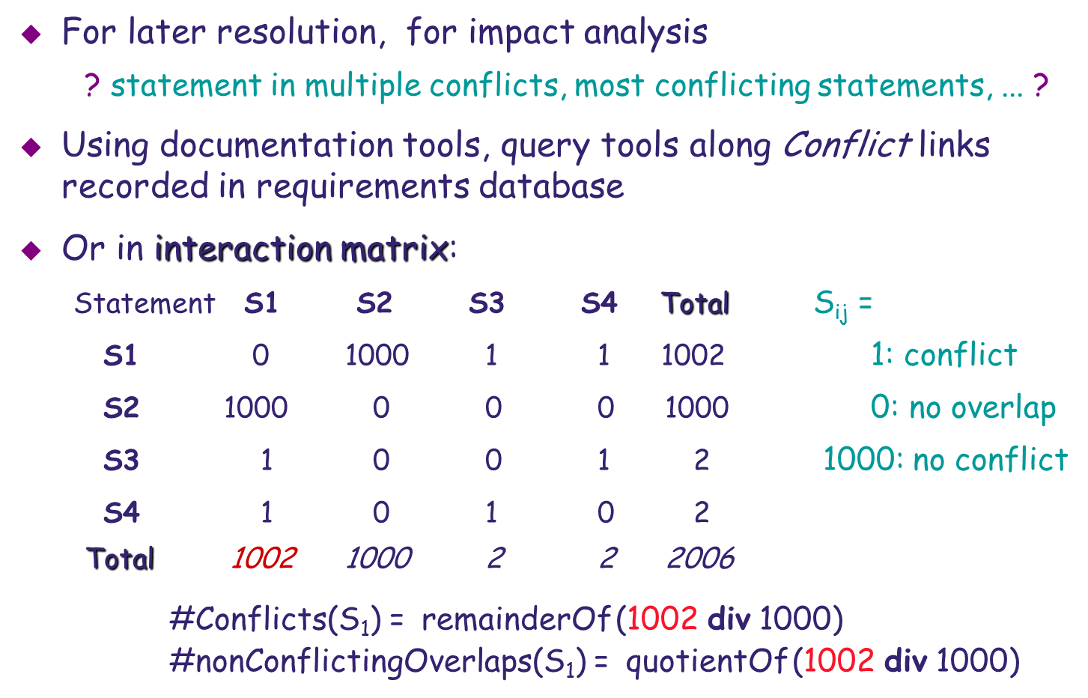
Detected conflicts should be documented
Step 2 : (cont’) – Document them

Slide 13
Managing conflicts: a systematic process (2)
Step 3 : Generate Conflicts Resolutions
For optimal resolution, better to ...
explore multiple candidate resolutions first,
compare, select/agree on most preferred next
To generate candidate resolutions, use ...
elicitation techniques
(interviews, group sessions) – as discussed in previous chapter
resolution tactics – let’s discuss in next slide

Slide 14


Conflict resolution tactics
(Refer to the example of library system discussed earlier….)
Avoid boundary condition
e.g. “Keep copies of highly needed books unborrowable”
Restore conflicting statements
e.g. “Copy returned within X weeks and then borrowed again”
Weaken conflicting statements
e.g. “Copy returned within X weeks unless explicit permission”
Drop lower-priority statements
Specialize conflict source or target
e.g. “Book loan status known by staff users only”

Slide 15
Managing conflicts: a systematic process (3)
Step 4 : Evaluation Conflicts & Selection
Evaluation criteria for preferred resolution:
contribution to critical non-functional requirements
contribution to resolution of other conflicts & risks
Will discuss in ...
Evaluating Alternative Options Section (in later part)

Slide 16
Managing conflicts: Q & A
Will we stop the managing conflicts process after completing step 4 (as discussed in previous slides)???
Answer…
It depends… we may need to go through the process due to error, incompleteness, new conflicts caused by new requirements(because of business environment changes), etc…

Slide 17
Requirements evaluation: outline
Inconsistency management
Types of inconsistency
Handling inconsistencies
Managing conflicts: a systematic process (overview)
Risk analysis
Types of risk
Risk management
Risk documentation
DDP: quantitative risk management for RE
Evaluating alternative options for decision making
Requirements prioritization

Slide 18

What is a risk ?
Uncertain factor whose occurrence may result in loss of satisfaction of a corresponding objective
e.g.- .- a passenger forcing doors opening while train moving
A risk has...
a likelihood of occurrence,
one or more undesirable consequences
e.g. - passengers falling out of train moving with doors open
Each risk consequence has ...
a likelihood of occurrence if the risk occurs
(not to be confused with risk likelihood)
a severity: degree of loss of satisfaction of objective
consequence 1
consequence 2
risk
occurrence
consequence n

Slide 19

Types of RE risk
Product-related risks: negative impact on functional or non-functional objectives of the system
=> failure to deliver services or quality of service
e.g.1: failure to generate monthly sales report
e.g.2: security threats, safety hazards
Process-related risks: negative impact on development objectives
=> delayed delivery, cost overruns, ...
e.g. personnel turnover

Slide 20
RE risk management
what system-specific risks?
countermeasures as new reqs
likely?
severe, likely consequences?
Risk management is iterative
Poor risk management is a major cause of software failure

Slide 21
Risk identification: Risk Checklists
A technique to consider checklists of common risks for a specific project.
Instantiation of risk categories to project specifics
associated with corresponding req categories (refer Chap. 1)
Product-related risks: req unsatisfaction in functional or quality req categories
info inaccuracy, unavailability, unusability, poor response time, poor peak throughput, ...
Process-related risks: top 10 risks [Boehm, 1989]
req volatility, personnel shortfalls, dependencies on external sources, unrealistic schedules/budgets, ...
poor risk management

Slide 22

Risk identification:Component Inspection
A technique for identifying product-related risks
Review each component of the system-to-be: human, hardware devices, software component, DB, ...
can it fail?
how?
why?
what are possible consequences?
e.g. Let’s discuss in lecture…
Can use to review on finer-grained components => more accurate analysis
e.g. acceleration controller, doors controller, track sensors, ...

Slide 23

Risk identification: Risk Trees
Risk Trees - More systematic technique on component inspection
Tree organization for causal linking of failures, causes, consequences
Eg. Called fault trees in safety, threat trees in security
Failure node = independent failure event or condition
decomposable or basic nodes
AND/OR links: causal links through logical nodes ...
AND-node: child nodes must all occur for parent node to occur as consequence
OR-node: only one child node needs to occur

Slide 24
Risk tree: example

Slide 25
Building risk trees: heuristic identification of failure nodes
Checklists, component failure
Guidewords = keyword-based patterns of failure
NO: “something is missing”
MORE: “there are more things than expected”
LESS: “there are fewer things than expected”
BEFORE: “something occurs earlier than expected”
AFTER: “something occurs later than expected”
But ... problems frequently due to combinations of basic failure events/conditions ...

Slide 26
Analyzing failure combinations: cut set of a risk tree
Cut set of risk tree RT: set of minimal AND-combinations of RT’s leaf nodes sufficient for causing RT’s root node
Cut-set tree of RT: set of its leaf nodes = RT’s cut set
Derivation of cut-set tree CST of RT:
CST’s top node := RT’s top logical node
If current CST node is OR-node:
expand it with RT’s corresponding alternative child nodes
If current CST node is AND-node:
expand it in single aggregation of RT’s conjoined child nodes
Termination when CST’s child nodes are all aggregations of leaf nodes from RT

Slide 27
Cut-set tree derivation: example
Cut set = {{TM, WR}, {TM, WA}, {TM, WS}, {TM, WI}, {TM, DAF}, {TM, SF}, {TM, PFDO}}
i.e. all combinations of bad circumstances for root risk to occur

Slide 28

Risk identification: using elicitation techniques
Scenarios to point out failures from WHAT IF questions
WHAT IF … interactions not occurring
WHAT IF … interactions occurring too late
WHAT IF … unexpected interactions (e.g. under wrong conditions)
WHAT IF ...
Knowledge reuse: typical risks from similar systems
Group sessions focussed on identification of project-specific risks

Slide 29
Risk assessment
Goal:
assess likelihood of risks + severity,
likelihood of consequences,
to control high-priority risks
2 types of risk assessment:
Qualitative assessment
Quantitative assessment

Slide 30
Qualitative risk assessment (1)
Qualitative assessment:
use qualitative estimates (levels)
for likelihood: {very likely, likely, possible, unlikely, ...}
for severity: {catastrophic, severe, high, moderate, ...}
=> risk likelihood-consequence table for each risk
=> risk comparison/prioritization on severity levels

Slide 31
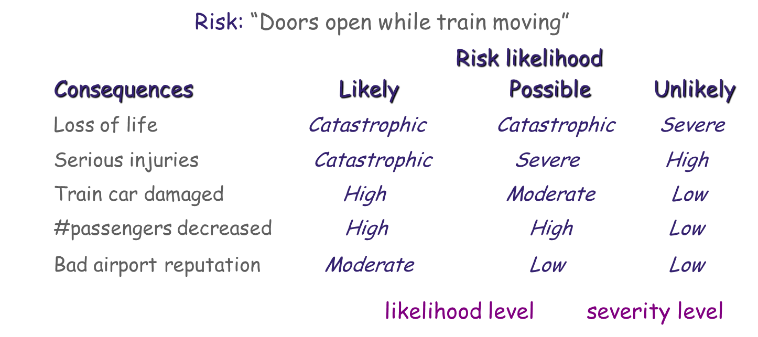
Qualitative risk assessment table: example
J Easy to use
L Limited conclusions: coarse-grained(rough info), subjective estimates,
likelihood of consequences not considered

Slide 32
Quantitative risk assessment
Quantitative assessment: use numerical estimates
for likelihoods:{0, 0.1, 0.2, ..., 0.9, 1.0} probability values
or{0-0.3, 0.3-0.5, 0.5-0.7, 0.7-1.0}probability intervals
for severity: scale from 1 to 10
=> Risk exposure for risk r with independent consequences c:
Exposure (r) = ∑_{c} Likelihood (c) × Severity (c)
=> Risk comparison/prioritization based on exposures
(with risks weighted by their likelihood of occurrence
→ give higher consideration to risks with higher exposure)
J Finer-grained than qualitative assessment
L Inaccurate & subjective estimates, to be elicited from domain experts or data collection from accumulated experiments

Slide 33
Risk control
Goal: Reduce high-exposure risks through countermeasures
yields new or adapted requirements
should be cost-effective
2 main steps in risk control:

Slide 34
Exploring countermeasures
Using elicitation techniques
interviews, group sessions
Reusing known countermeasures
e.g. generic countermeasures to top 10 risks [Boehm, 1989]
simulation " poor performance
prototyping, task analysis " poor usability
use of cost models " unrealistic budgets/schedules
Using risk reduction tactics (next slides…)

Slide 35
Risk reduction tactics (1)
Reduce risk likelihood: new reqs to ensure significant decrease
e.g. “Prompts for driver reaction regularly generated by software”
Avoid risk: new reqs to ensure risk may never occur
e.g. “Doors may be opened by software-controlled actuators only”
Reduce consequence likelihood: new reqs to ensure significant decrease of consequence likelihood
e.g. “Alarm generated in case of door opening while train moving”

Slide 36
Risk reduction tactics (2)
Avoid risk consequence: new reqs to ensure consequence may never occur
e.g. “No collision in case of inaccurate speed/position estimates”
Mitigate risk consequence: new reqs to reduce severity of consequence(s)
e.g. “Waiting passengers informed of train delays”

Slide 37
Question ???
Assume you are a project manager, suggest one tactic for the following risks that happened in your project :
High staff turnover
User keep changing requirements

Slide 38
Selecting preferred countermeasures
Evaluation criteria for preferred countermeasure:
contribution to critical non-functional requirements
contribution to resolution of other risks
cost-effectiveness
Cost-effectiveness is measured by risk-reduction leverage:
RRL (r, cm) = (Exp (r) − Exp (r|cm)) / Cost (cm)
Exp (r): exposure of risk r
Exp (r|cm): new exposure of r if countermeasure cm is selected
=> Select countermeasures with highest RRLs
refinable through cumulative countermeasures & RRLs

Slide 39

Risks should be documented
To record/explain why these countermeasure reqs, to support system evolution
For each identified risk, documentation should include:
conditions/events for occurrence
estimated likelihood
possible causes & consequences
estimated likelihood & severity of each consequence
identified countermeasures + risk-reduction leverages
selected countermeasures
annotated risk tree

Slide 40
Requirements evaluation: outline
Inconsistency management
Types of inconsistency
Handling inconsistencies
Managing conflicts: a systematic process
Risk analysis
Types of risk
Risk management
Risk documentation
DDP: quantitative risk management for RE
Evaluating alternative options for decision making
Requirements prioritization

Slide 41
DDP: Quantitative risk management for RE
DDP = Defect Detection Prevention
Technique & tool developed at NASA [Feather, 2003]
Quantitative support for Identify-Assess-Control cycles
Three steps:

Slide 42
Step 1: Elaborate the Impact matrix
Build a risk-consequence table with domain experts for ...
prioritizing risks by critical impact on all objectives
highlighting the most risk-driving objectives
For each objective obj, risk r:
Impact (r, obj) = estimated loss of satisfaction of obj by r
0 (no loss) --> 1 (total loss)
Last line, for each risk r:
Criticality (r) = Likelihood (r) × ∑_{obj} (Impact (r, obj) × Weight (obj))
Last column, for each objective obj:
Loss (obj) = Weight (obj) × ∑_{r} (Impact (r, obj) × Likelihood (r))

Slide 43
Impact matrix: example for library system
Last line, for each risk r:
Criticality (r) = Likelihood (r) × ∑_{obj} (Impact (r, obj) × Weight (obj))
Last column, for each objective obj:
Loss (obj) = Weight (obj) × ∑_{r} (Impact (r, obj) × Likelihood (r))

Slide 44
Step 2: Elaborate the Effectiveness matrix
Build a risk-countermeasure table with domain experts for ...
estimating risk reduction by alternative countermeasures
highlighting most globally effective countermeasures
For each countermeasure cm, weighted risk r:
Reduction (cm, r) = estimated reduction of r if cm applied
0 (no reduction) --> 1 (risk elimination)
Last line, for each risk r:
combinedReduction (r) = 1 − Π_{cm} (1 − Reduction (cm, r))
Last column, for each countermeasure cm:
overallEffect (cm) = ∑_{r} (Reduction (cm, r) × Criticality (r))

Slide 45
Effectiveness matrix: example for library system
Last line, for each risk r:
combinedReduction (r) = 1 − Π_{cm} (1 − Reduction (cm, r))
Last column, for each countermeasure cm:
overallEffect (cm) = ∑_{r} (Reduction (cm, r) × Criticality (r))

Slide 46
Step 3: Determine optimal balance risk reduction vs. countermeasure cost
Cost of each countermeasure cm to be estimated with domain experts
DDP can then visualize ...
risk balance charts: residual impact of each risk on all objectives if cm is selected
optimal combinations of countermeasures for risk balance under cost constraints

Slide 47
Requirements evaluation: outline
Inconsistency management
Types of inconsistency
Handling inconsistencies
Managing conflicts: a systematic process
Risk analysis
Types of risk
Risk management
Risk documentation
DDP: quantitative risk management for RE
Evaluating alternative options for decision making
Requirements prioritization

Slide 48
Evaluating alternative options for decision making
The RE process raises multiple alternative options of different types
alternative ways of satisfying a system objective
alternative assignments of responsibilities among system components
alternative resolutions of a conflict
alternative countermeasures to reduce a risk
Preferred alternatives must be negotiated, selected ...
agree on evaluation criteria (e.g. contribution to NFRs)
compare options according to criteria
select best option
Qualitative or quantitative reasoning techniques

Slide 49
Qualitative reasoning for evaluating options
Goal: determine qualitative contribution of each option to important non-functional requirements (NFRs):
very positively (++), positively (+), negatively (-), very negatively (--)
Example: meeting scheduling

Slide 50
Quantitative reasoning for evaluating options
Build a weighted matrix for ...
estimating score of each option on each evaluation criterion (weighted by relative importance)
selecting option with highest overall score on all criteria
For each option opt, criterion crit:
Score (opt, crit) = estimated score percentage of opt on crit
0 --> 1, Y/100 means “crit satisfied in Y% of cases”
Last line, for each option opt:
totalScore (opt) = ∑_{crit} (Score (opt, crit) × Weight (crit))

Slide 51
Requirements evaluation: outline
Inconsistency management
Types of inconsistency
Handling inconsistencies
Managing conflicts: a systematic process
Risk analysis
Types of risk
Risk management
Risk documentation
DDP: quantitative risk management for RE
Evaluating alternative options for decision making
Requirements prioritization

Slide 52
Requirements prioritization (1)
M
Elicited & evaluated reqs must be assigned priorities ...
conflict resolution
resource limitations (budget, personnel, schedules)
incremental development
replanning due to unexpected problems
Too early ranking at elicitation time might be subjective
=> risk of inadequate, inconsistent results

Slide 53
Requirements prioritization (2)
M
Some principles for effective req prioritization ...
(1) by ordered levels of equal priority, in small number
(2) qualitative & relative levels (“higher than”, ...)
(3) comparable reqs: same granularity, same abstraction level
(4) reqs not mutually dependent (one can be kept, another dropped)
(5) agreed by key players

Slide 54
Value-cost prioritization
M
Systematic technique, meets principles (1) - (3)
Three steps:
1. Estimate relative contribution of each req to project’s value
2. Estimate relative contribution of each req to project’s cost
3. Plot contributions on value-cost diagram: shows what req fits what priority level according to value-cost tradeoff

Slide 55
ANY QUESTION…

